Slide 1
OSINT
Beware. Your data is out there.

Slide 2
OSINT – Open-source intelligence Digital Footprint
Open-source intelligence (OSINT) is the collection and analysis of data gathered from open sources (overt and publicly available sources) to produce actionable intelligence. (Wikipedia)
It’s about digital footprint. Gathering information from:
search engines (Google, …)
social media (Facebook, …)
government sites
…
The constant battles:
Privacy vs Publicaly available information
Convinience vs Security

Slide 3
Disclaimer & Laws

Slide 4

Disclaimer Boring but necessary
Information in this presentation is intended for educational and awareness purposes only.
Live presentation. Not a controlled environment and some contents may be inappropriate for some users.
I accept no responsibility in any kind for the use, misuse, downloading, viewing in whatever way the links in this presentation.
This presentation is not related to my work or employer.

Slide 5
Disclaimer Avoid illegal activities
Some links, websites, software or other items listed may or may not be legal, illegal, a felony, misdemeanor, or worse, in your country.
Please make sure that you are allowed to browse the websites, download links and software BEFORE USING!
Ignorance about laws or rules is no excuse for illegal activities or wrongdoing.
Illegal activities may get you in trouble or arrested.
Always check what is legal, and what laws apply.

Slide 6
Laws Portuguese Law and Organizations
Laws
Diário República Eletrónico (link)
ANACOM (link)
Organizations
CNCS – Centro Nacional de Cibersegurança (link)
Incident Notification (link)
CERT.PT (link)
Unidade Nacional de Combate ao Cibercrime e à Criminalidade Tecnológica (UNC3T) (link)
Ministério Público (link)

Slide 7
OSINT GEO

Slide 8
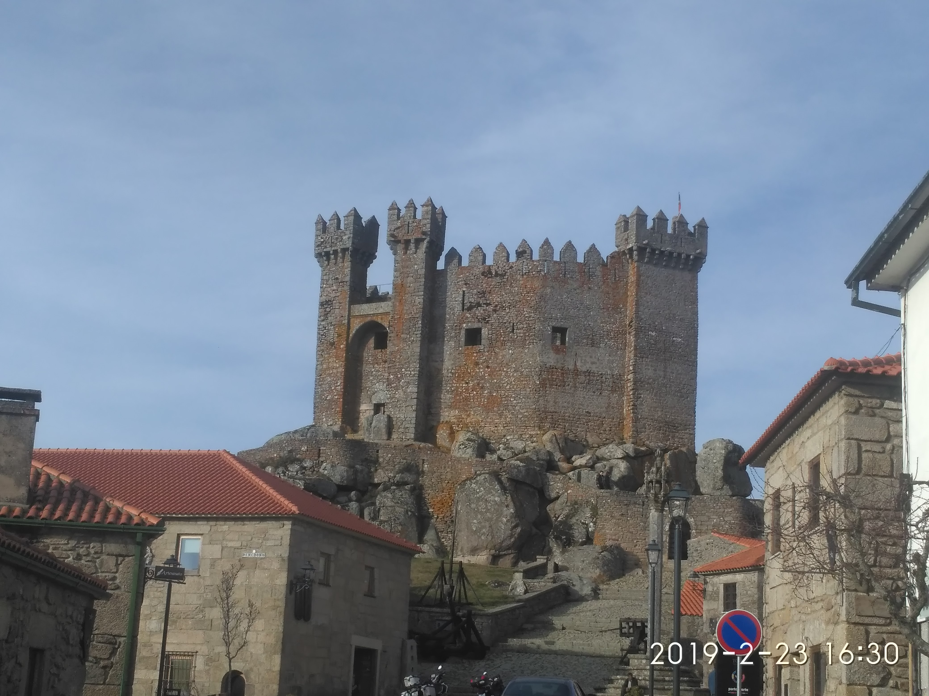
OSINT - Photos Lots of Information
Where was this image taken?
Have you been there?
When?
Date stamp on photo
Filename with date
Metadata
What else?
Image search
Identify the castle?

Slide 9
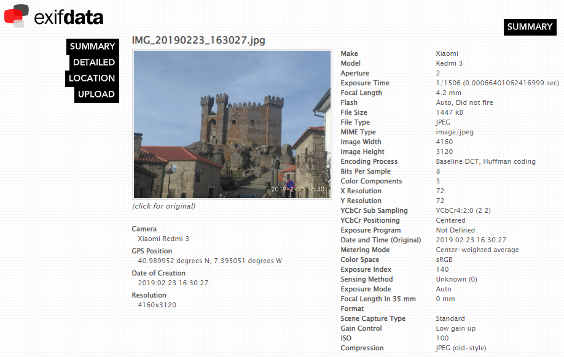
OSINT - Photos Metadata
Metadata
GPS (link)
Google Maps (link)

Slide 10
Search Geolocation
Digital Cameras/Mobile Phones
Metadata
Geolocation
Camera Model
Breasts lead to arrest of Anonymous hacker (link)
Police allege that an Anonymous hacker posted a picture of his presumed girlfriend's breasts as a taunt to U.S authorities. The picture allegedly contained GPS information that led the FBI to her.
Stolen goods being sold online can eventually be tracked

Slide 11
OSINT (Reverse) Image search
One image is worth 1000 words, maybe more.
What information can be extracted from a photo ?
Google Images (link)
Bing Images (link)
Yahoo Images (link)
Tineye (link)
Yandex (link)
The professionals (video explaining) (link)

Slide 12
OSINT Street View
Google Street View (link)
Identify house by address
Assess security (cameras, fences, ...)
Parked cars (timeline, ...)
People’s habits/routines, timetables, ...
View the past – timeline (link)
Instant Street View (link)

Slide 13
OSINT Maps
Google Maps (link)
Bing Maps (link)
Wikimapia (link)
Tips, Tricks and Techniques (link)

Slide 14
Search Satellite View
Zoom Earth (link)
Satellites Pro (link)
World Imagery (link)
Wayback (link)
Wayback example (link)
View the past - timeline

Slide 15
OSINT MEMORY

Slide 16
Wayback Machine Internet in the past
Wayback Machine (link)
Example (link)
Archive.is (link)
Cached Pages (link)
Cached View (link)
OldWeb.Today (link)
Time Travel (link)
Github commits ☺

Slide 17
OSINT IOT

Slide 18
Shodan Search Engine for Internet Of Things
Internet Exposure Observatory
Exposure Dashboard (link)
Explore
Shodan explore (link)
Images
Shodan images (link)
Maps
Shodan maps (link)

Slide 19
Shodan Internet of Things
Remote Desktop (link)
Total results: 3,482,756
Braga (link)
Images
Braga (link)
VNC Remote Access and Loggedin (link)
Authentication Disabled
Portugal (link)
Primavera (link)
Contabilidade (link)

Slide 20
Shodan Internet of Things
Fotos
Portugal (link)
IP Cameras
Portugal (link) (default credentials?)
Webcams (link)

Slide 21
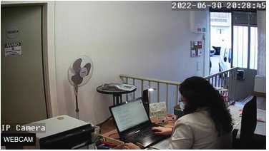
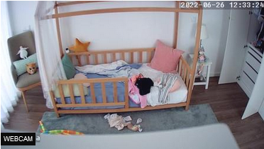
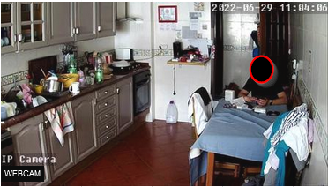
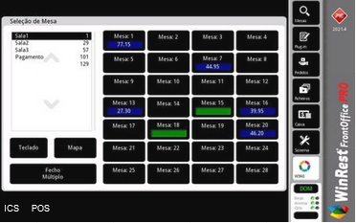
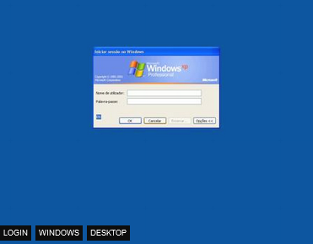
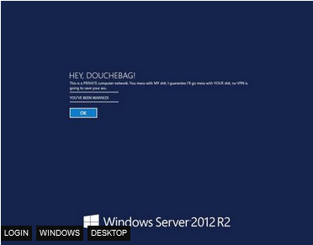
Shodan Internet of Things - Images

Slide 22
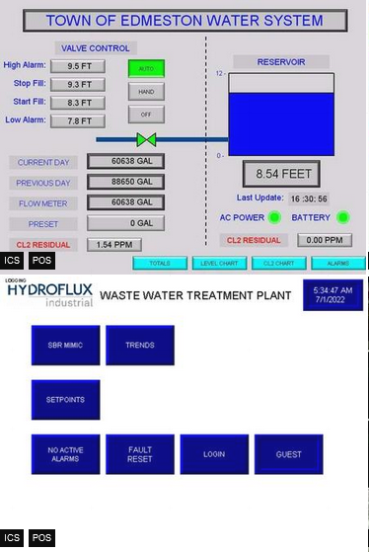
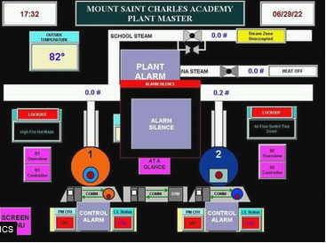
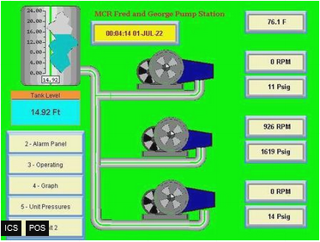
Shodan Industrial Control Systems
Industrial Control Systems (link)

Slide 23
Shodan Portugal – Internet Exposure
Internet Exposure Dashboard (link)
Top Vulnerability
CVE-2015-0204 – CVSS2 4.3 Medium (link)
BlueKeep Unpatched (link)
107 (link)
Industrial Control Systems
516
SMB (shared folders)
Authentication Disabled: 2898

Slide 24
ONLINE SAFETY

Slide 25
Helping Tools Privacy
VPN (Different country, different advertisements, what else ?)
ProtonVPN (link)
Temporary Email (Need to register? Activate software?)
10 minute email (link)
20 minute email (link)
Disposable Email
60 minute email (link)
Internet Access (DarkWeb included)
Tor (link) (internet browser)
Tails (link) (OS that runs on usb or VM)

Slide 26
Helping Tools Safety
VirusTotal
Check received files (link)
(don’t upload Personal or Company related information)
Netcraft
Sitereport (link) (check for suspicious sites)
Ransomware
No More Ransom (link)
Virtual Credit Card (online shopping)
Mbnet (link)
Revolut (link)
PayPal (link)

Slide 27
Helping Tools Reverse Tracking
Gmail Plus Address (link) example email: mypersonalemail@gmail.com
If you append a “plus” sign to your email username, Gmail will ignore anything written between the + and @ sign in the email address and still deliver the message to the same mailbox.
Any email address sent to
mypersonalemail+linkedin@gmail.com
mypersonalemail+continente@gmail.com
mypersonalemail+financas@gmail.com
Will still reach the Gmail inbox of mypersonalemail@gmail.com inbox though, technically, they are three different email aliases.
Know who is sharing your email ☺

Slide 28
Passwords / Credentials Please don’t share
Kaspersky
Check your password (link)
(or maybe not)
Check last name – “vieira” or “Vieira” or “Vieira123”
Top 10 passwords
“qwerty”, “password”, …
Country specific: BR example “password” → “senha”
Daniel Miessler SecLists
Usernames (link)
Passwords (link)
Default Credentials (link)
IoT Default Passwords (link)

Slide 29
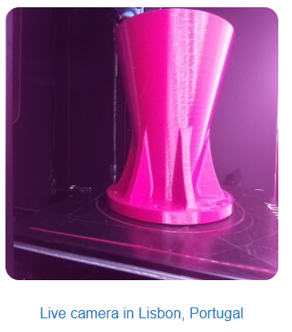
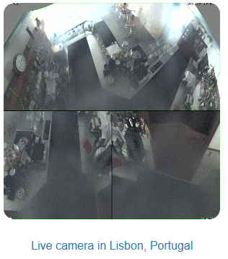
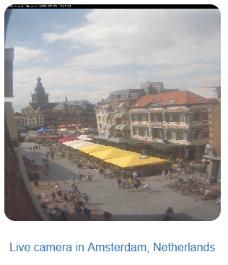
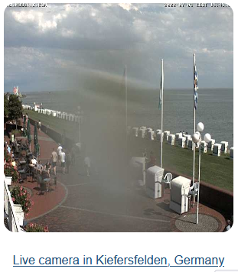
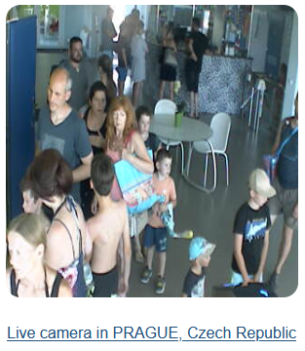
Insecure Insecure Cameras – Is your camera secure ?
Browser edit (link)
Portugal (link)

Slide 30
Databreach

Slide 31
Databreach Is not a thing of the past
Troy Hunt
HaveIBeenPwned (link)
Pwned websites (link)
Ashley Madison Breach 2015 (link)
When private data gets public
Piracy - Subtitles
Don’t think you can hide – Illegal activities are tracked
Companies are leaking all your information
Compromised data: Dates of birth, Email addresses, Employers, Family structure, Genders, Income levels, Living costs, Marital statuses, Mothers maiden names, Names, Phone numbers, Physical addresses, Places of birth, Religions, Spouses names

Slide 32
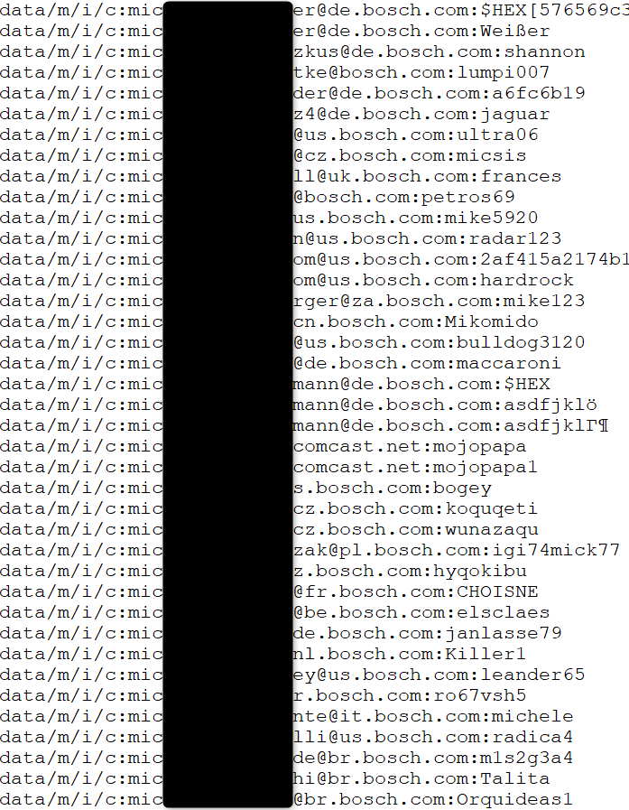
Databreach Company credentials ?
Email/Login
Password
Source
Publicly available list of credentials
More than 10k credentials just for Bosch
Information gathered
Rule of email/login
(FirstName.LastName)@(Country).(company).com
Rule of password complexity
List of users
Phishing campaigns
Brute force
Look for those users on Social Media
Added Problem
Credentials reuse

Slide 33
Databreach Portuguese domain examples (2018)
uminho.pt - Universidade do Minho
adv.oa.pt - Ordem dos Advogados
pj.pt - Policia Judiciária
mail.exercito.pt - Exército
cm-braga.pt - Câmara Municipal de Braga
cm-guimaraes.pt - Câmara Municipal de Guimarães
psd.pt - Partido Social Democrata
ps.pt - Partido Socialista
fcporto.pt - Futebol Clube do Porto
min.justiça - Ministério da Justiça
Were these the sources for criminal “hacker” Rui Pinto ?

Slide 34
Free to Share

Slide 35
License
Feel free to use/modify/share
Teach someone
Improve awareness

